Slide 1
NAAN MUDHALVAN SCHEME FUNDAMENTALS OF DATA ANALYTICS WITH TABLEAU
PROJECT TITLE: UNVEILING MARKET INSIGHTS

Slide 2
TEAM ID:NM2023TMID16084
TEAM LEAD: ID0A396DCED1054E59B3045AE7BC899098
TEAM MEMBERS ID:
70313CDB6F5E9FFA92A463F4728D5AF5
C75E72152839B2E8AD344B0AA7AF96D6
BF0A7D458BA88AF81E247599CE250271

Slide 3
Empathy map

Slide 4
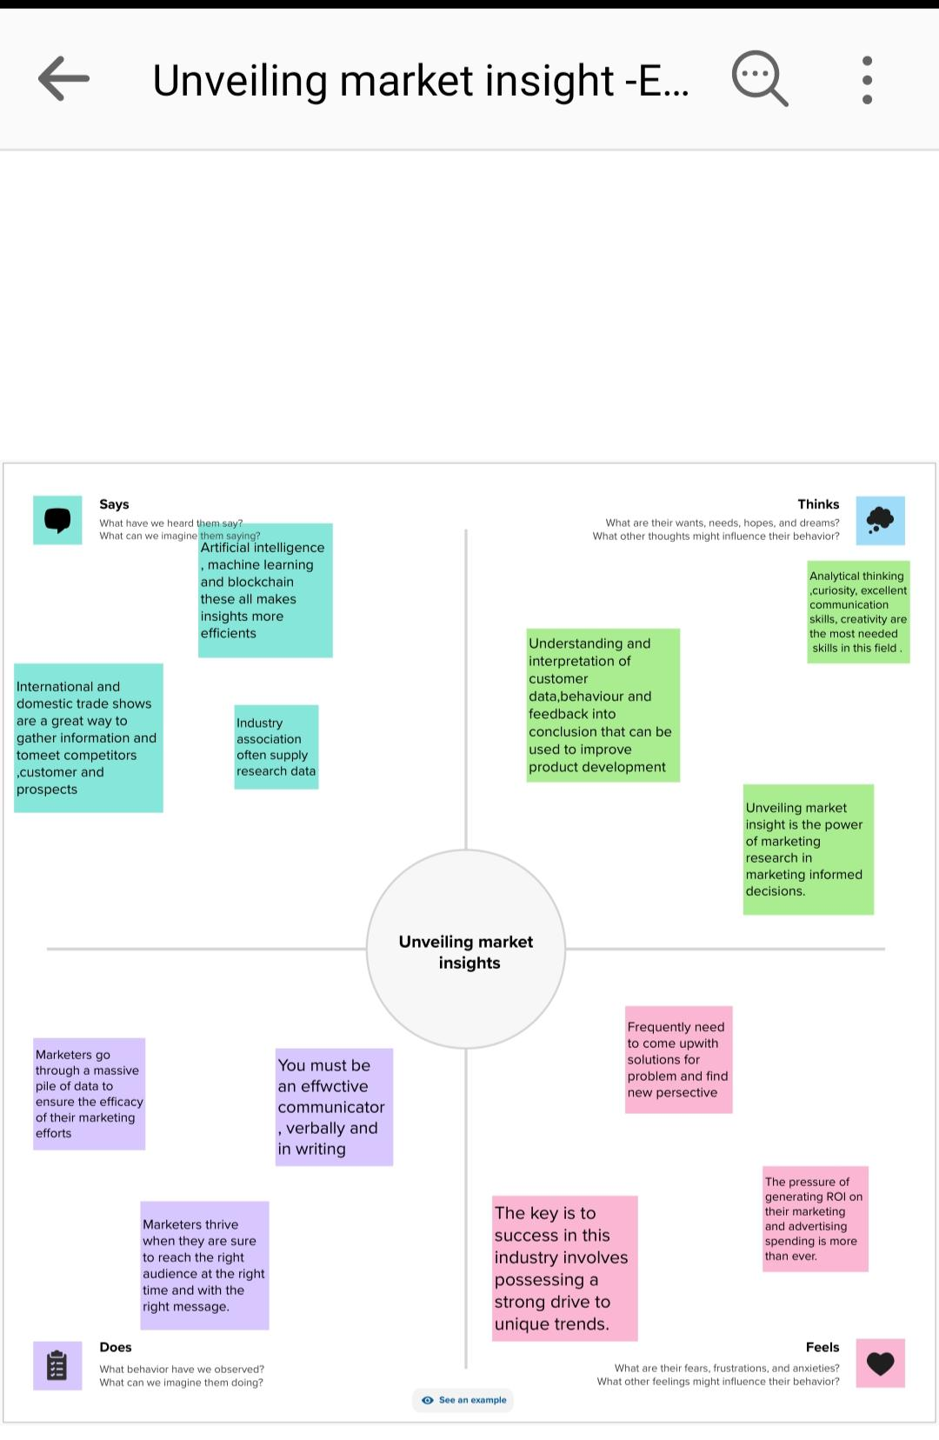

Slide 5
BRAINSTORMING MAP

Slide 6
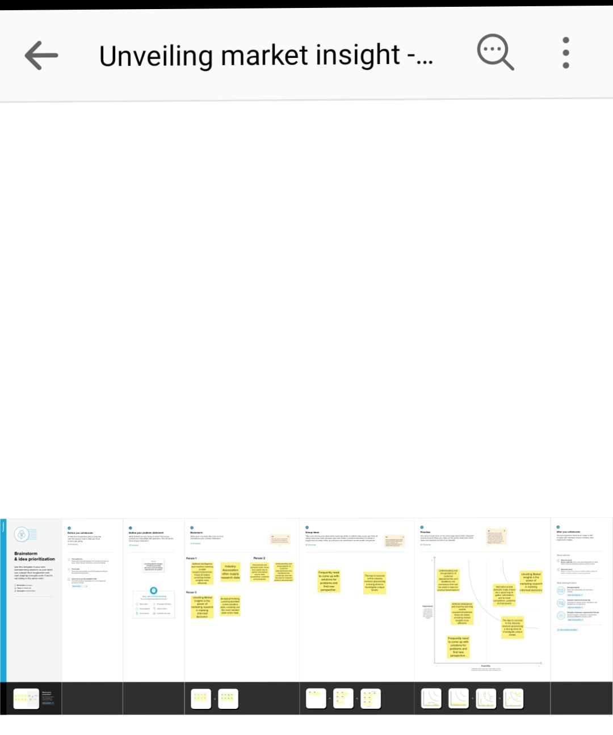
BRAINSTORMING MAP

Slide 7
DATA VISUALISATION

Slide 8
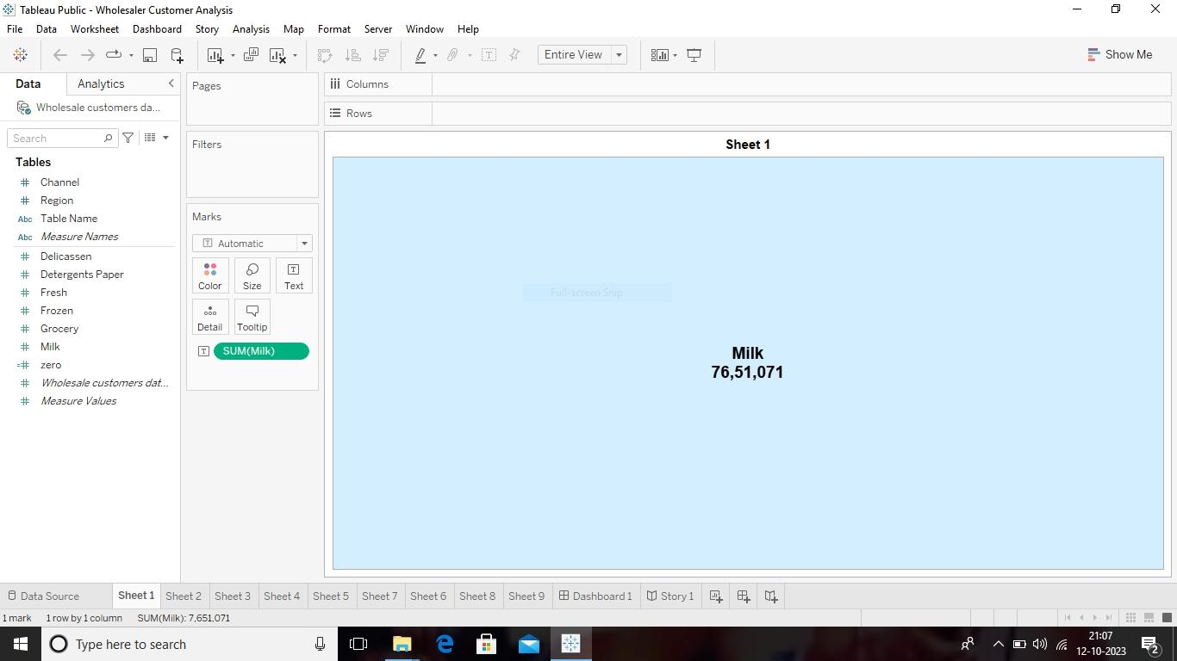
Sheet 1

Slide 9
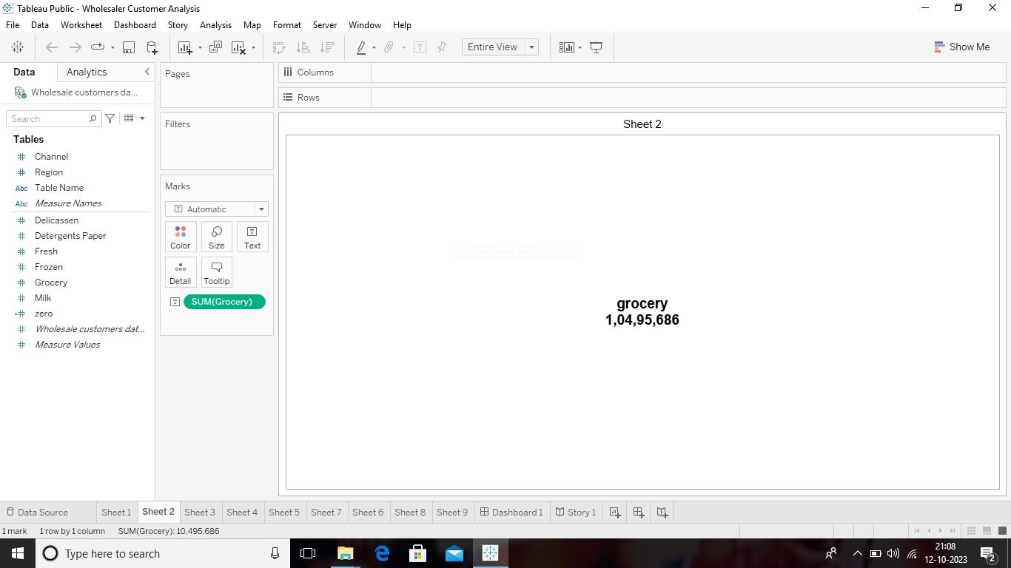
Sheet 2

Slide 10

Sheet 3

Slide 11
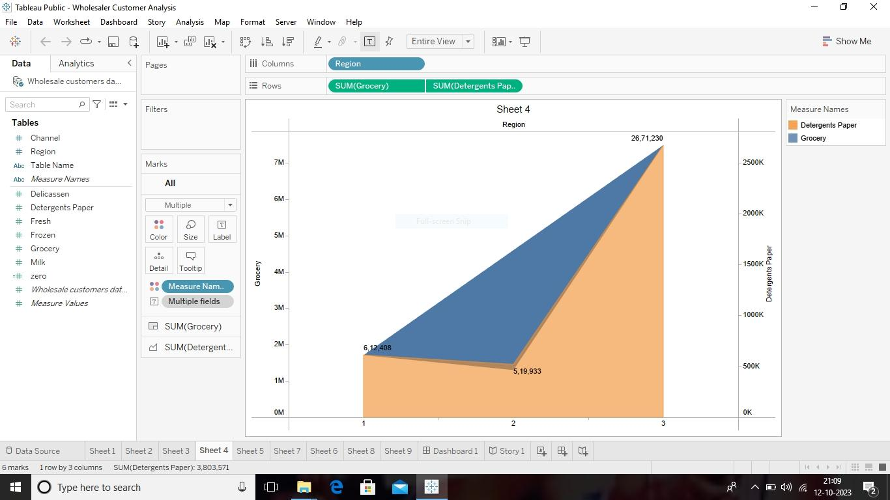
Sheet 4

Slide 12
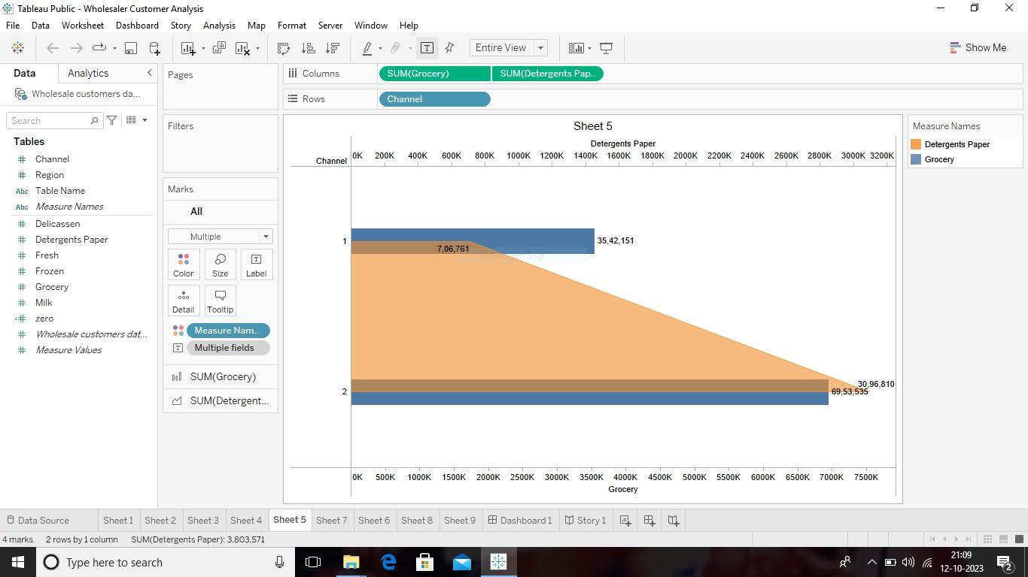
Sheet 5

Slide 13
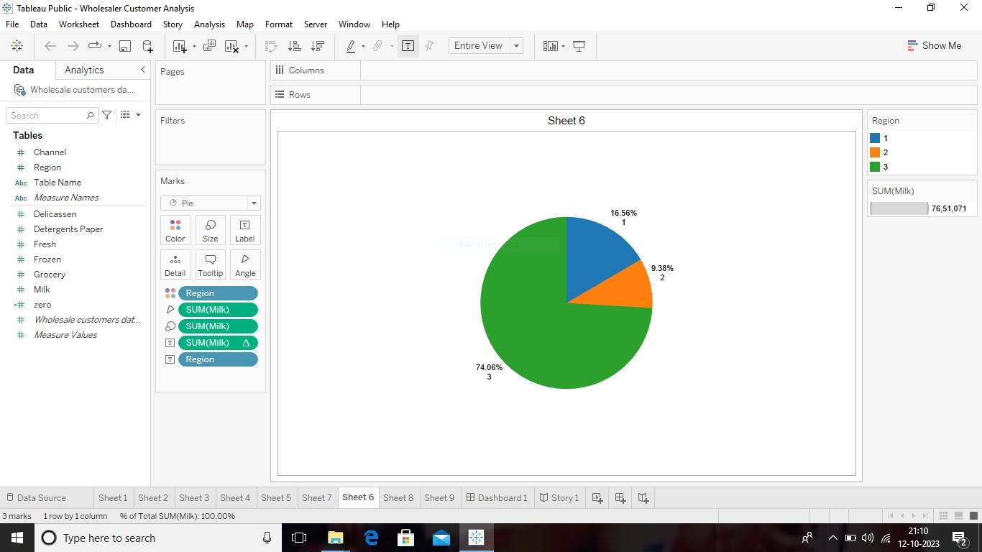
Sheet 6

Slide 14
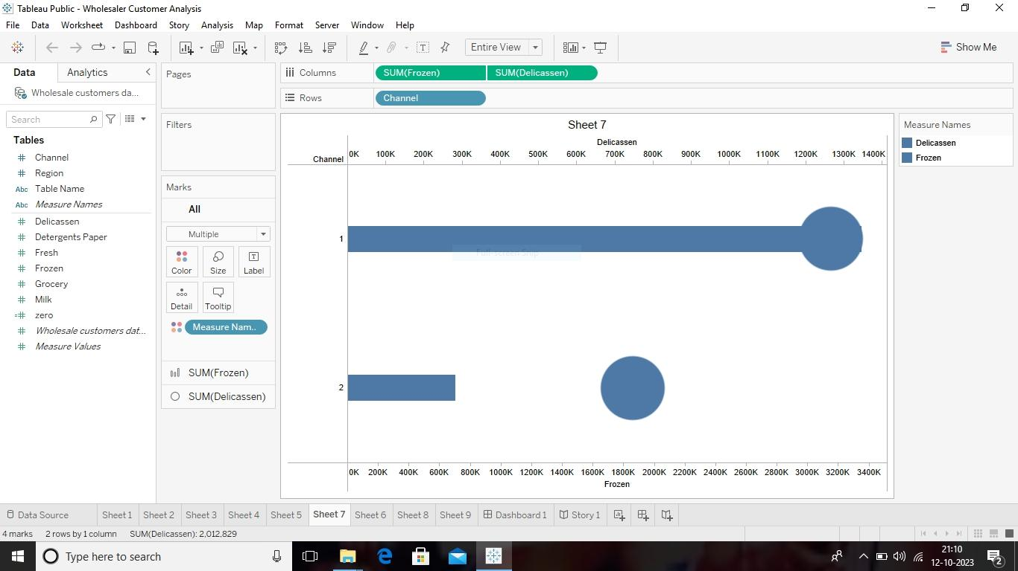
Sheet 7

Slide 15
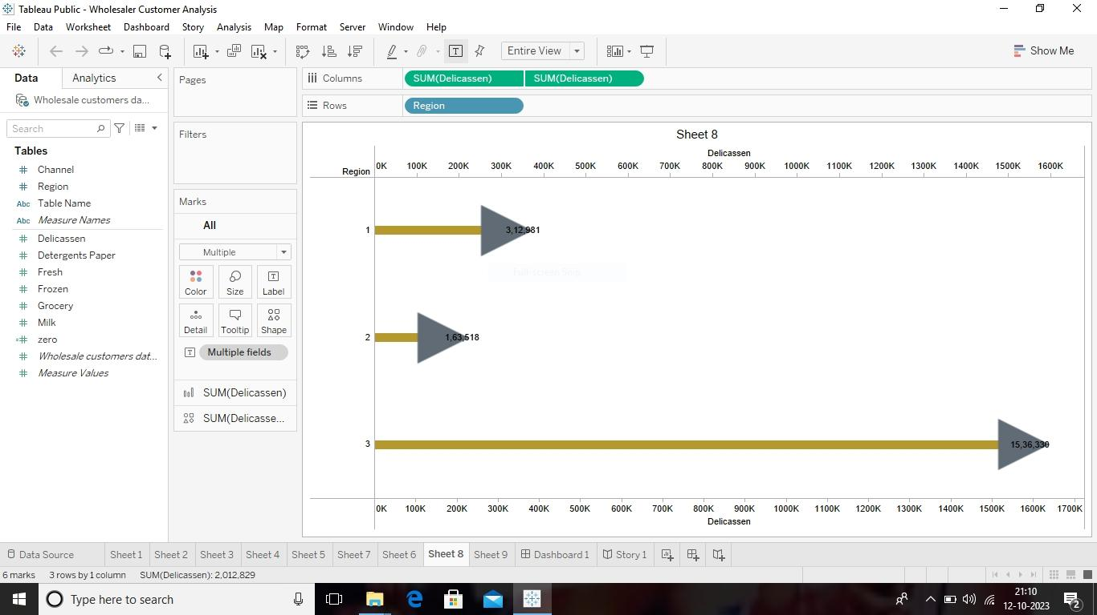
Sheet 8

Slide 16
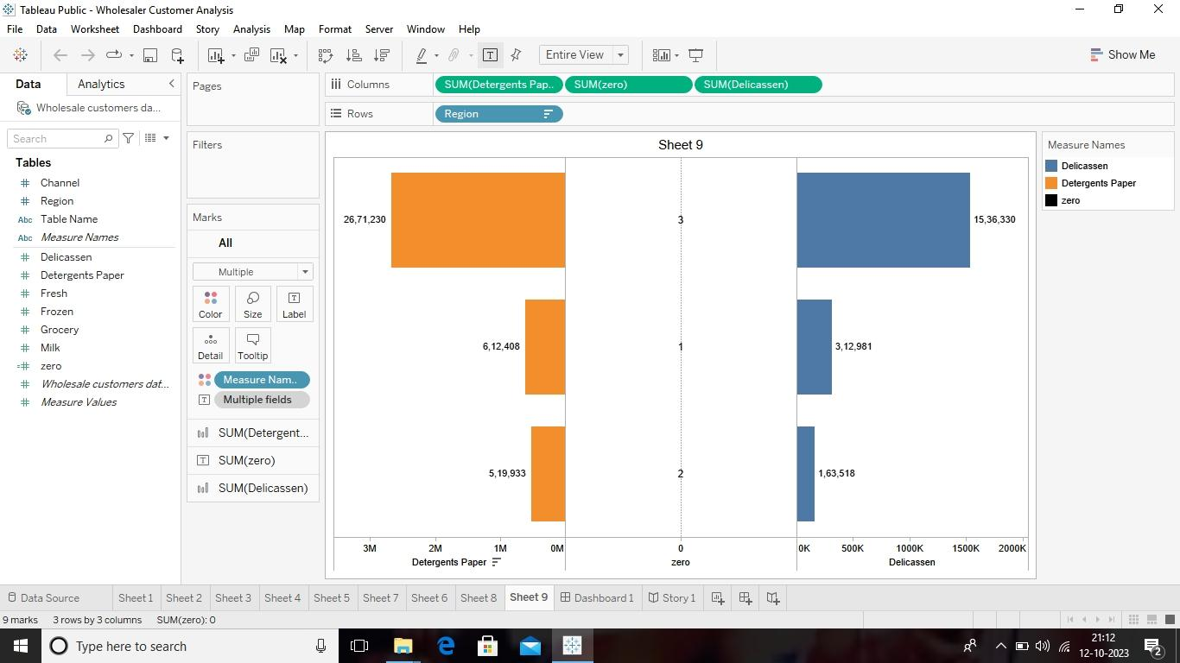
Sheet 9

Slide 17
Dashboard

Slide 18
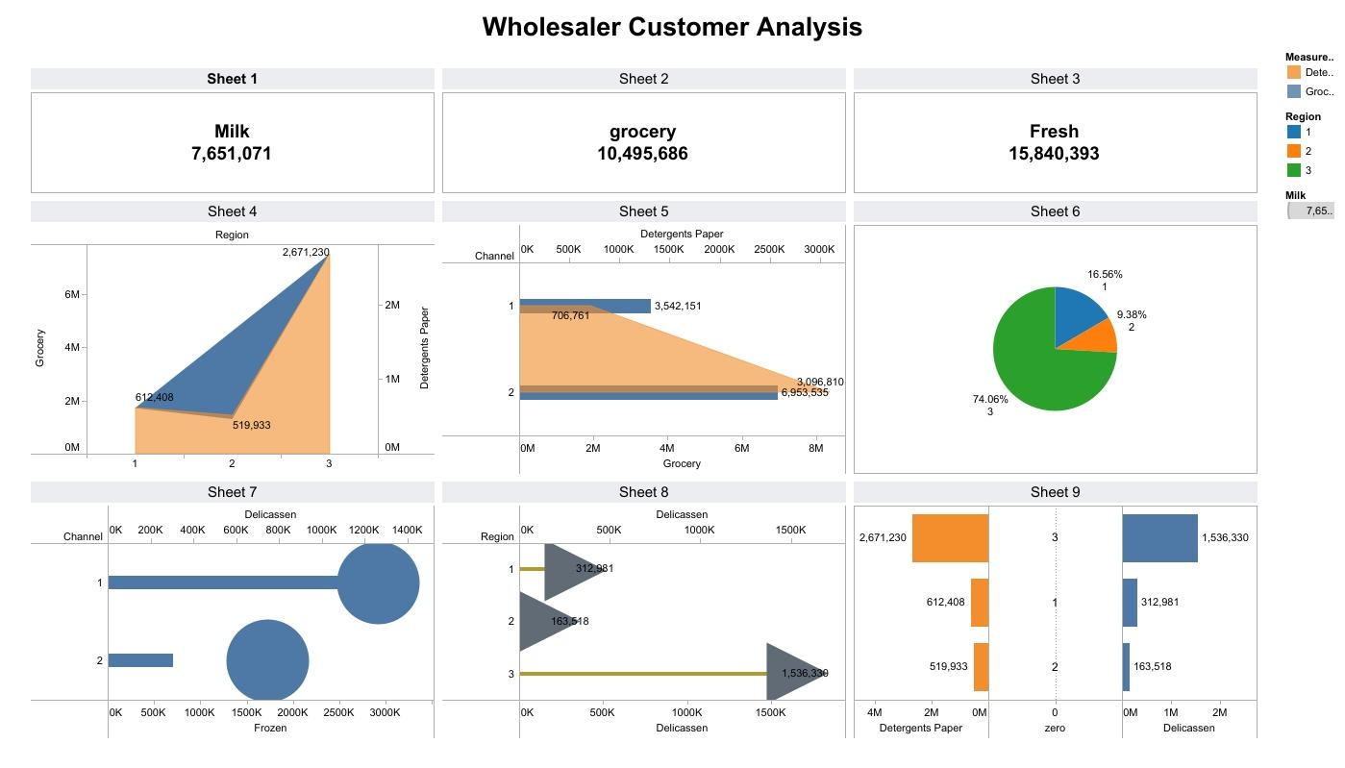

Slide 19
Story

Slide 20
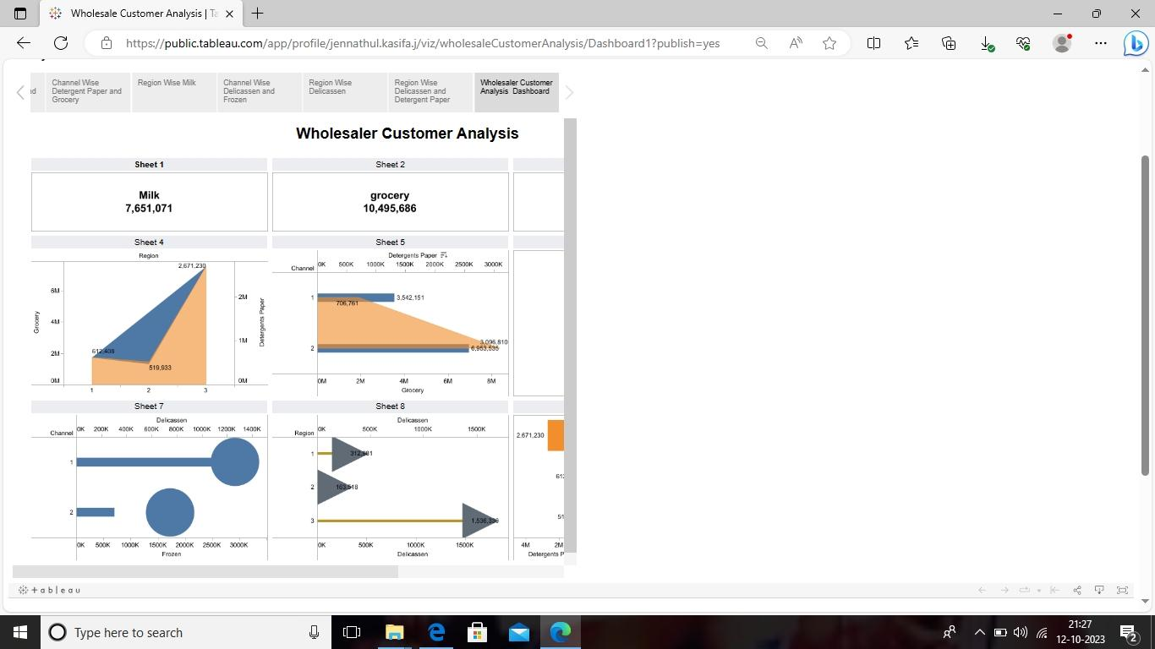

Slide 21
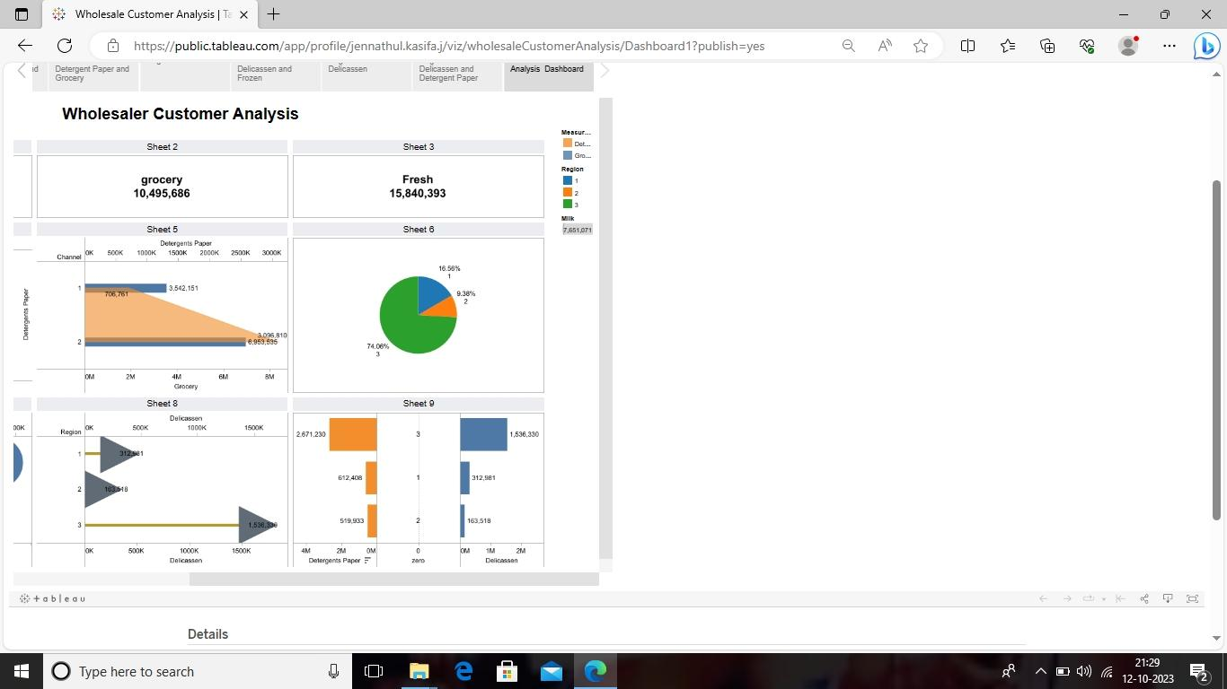

Slide 22
Thank you

